Slide 1
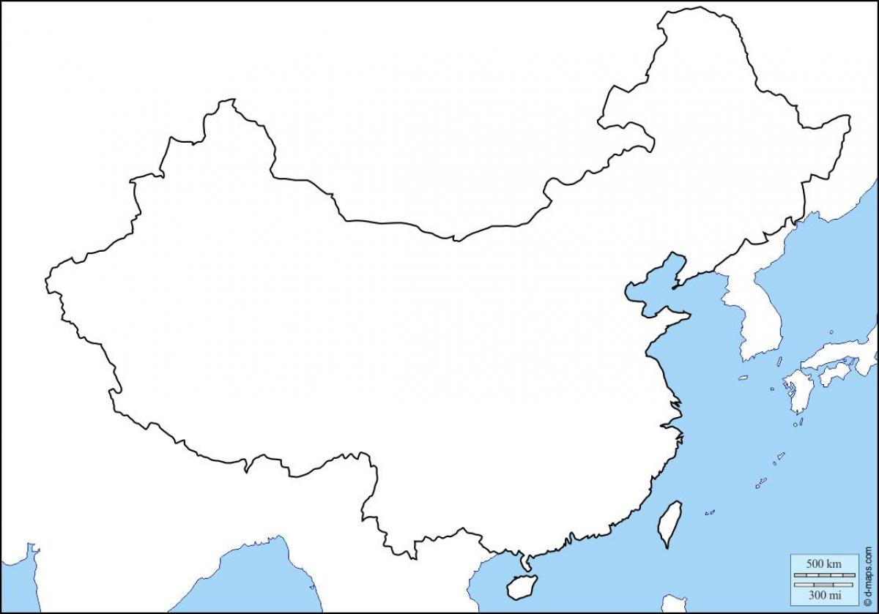

vLLM
vLLM
vLLM
Regional Server
vLLM
Regional Server
vLLM
Central Server
vLLM
vLLM
Regional Server

